Slide 1
ENGR 12
Dr. Mandala

Slide 2
About me
Assistant Professor in Bioengineering
Mechanical engineer focusing on medical device design
Research interests include product design, design education, and engineering education
Office: 225 A Benedum Hall
Office hours: TBA
E-mail: m.mandala@pitt.edu

Slide 3
My Course policies
Attend every class, avoid playing games, snapchat, etc. in class.
Follow in-class demos/practice handouts
Ask questions – I may not know all answers but I can find resources to help out
Spread out your work load – spend a few hours every other day for ENGR12
Meet with your TAs or me when you can’t find answers to your questions

Slide 4
Where was I week-1?
Transition from Student to Work Permit (I graduated recently!)
Special thanks to Prof. Budny for helping me out!

Slide 5

What have you learnt so far?

Slide 6
Review

Slide 7
Scripts
Collection of commands executed in sequence
Written in the MATLAB editor
Saved as an M-file (extension: .m)
Note that scripts are somewhat static, since there is no input and no explicit output
All variables created and modified in a script exist in the workspace even after it has stopped running
Source: MIT OpenCourseWare (http://ocw.mit.edu)

Slide 8
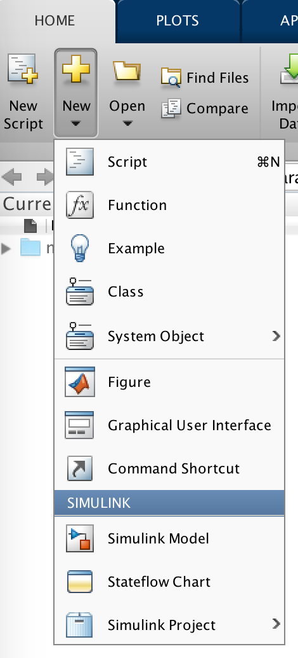
Creating scripts
Option 3: Use MATLAB’s edit command:
>> edit
to open an empty script, or
>> edit file-name.m
to open a script with given file-name that you choose for your script, e.g.,
>> edit myScript.m
Option 1: Use New Script shortcut
Option 2: Use New > Script shortcut

Slide 9
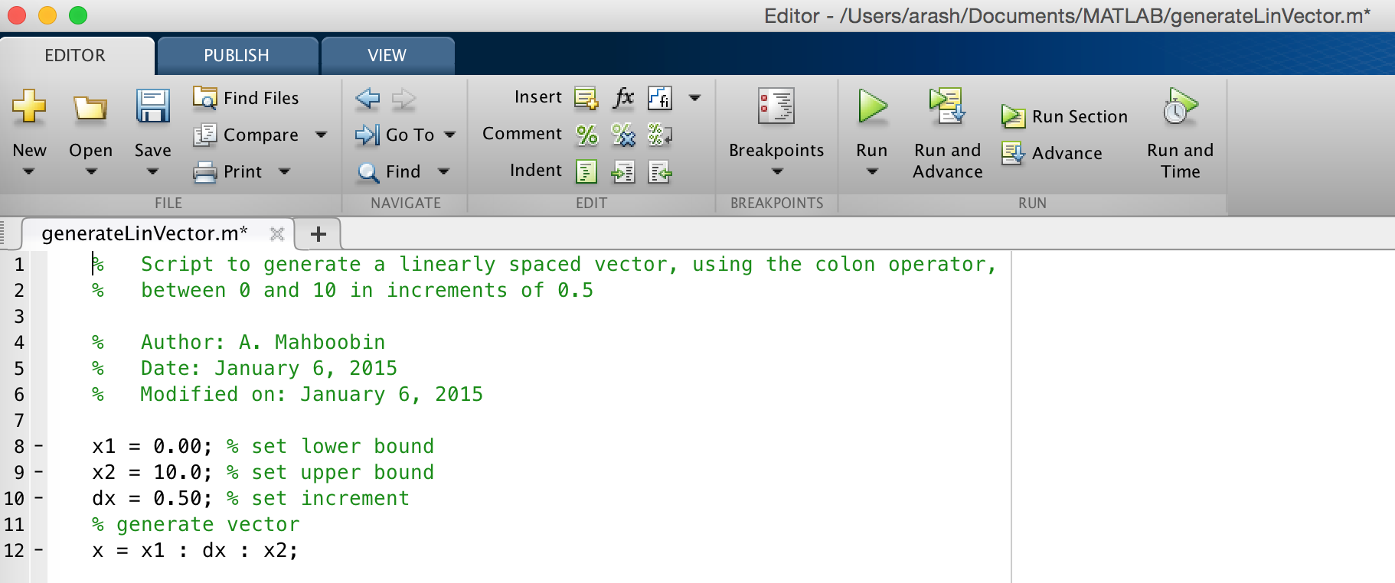
Editor
possible breakpoints (use for debugging code)
MATLAB file path
* means that the file is not saved
script documentation (i.e., help)
comments
Note: Anything following a percent (%) sign is seen as a comment. First sequence of comments becomes the script’s help file. Remember to comment your scripts thoroughly
line numbers
Source: MIT OpenCourseWare (http://ocw.mit.edu)

Slide 10
Indexing
Assume that:
>> x=[10,32,0.6]; %1x3 array (or row vector)
Pictorially,
10
32
0.6
index (or location) # (in MATLAB, always starts at 1)
1
2
3
To access a single element, must use appropriate index (or location) # and following syntax: variable-name(index#)

Slide 11
Indexing
Assume that:
>> x=[4,3;7,9]; %2x2 matrix
Pictorially,
1
4
3
2
7
9
row index (or location) #
column index (or location) #
1
2
To access a single element, must use appropriate row and column index (or location) #s and following syntax: variable-name(row# , column#)

Slide 12
Indexing
exampleS
Assume x=[1 2 30 1 12 2 100] and y=[34 12;0.1 4.7].
>> x(3) %returns 3rd element of x, i.e., 30
>> x(4) %returns 4th element of x, i.e., 1
>> x(7) %returns 7th element of x, i.e., 100
>> y(1,1) %returns element in 1st row, 1st column, i.e., 34
>> y(1,2) %returns element in 1st row, 2nd column, i.e., 12
>> y(2,1) %returns element in 2nd row, 1st column, i.e., 0.1
>> y(2,2) %returns element in 2nd row, 2nd column, i.e., 4.7

Slide 13
Indexing
colon (:) notation
The colon notation can be used to pick out selected rows, columns, and elements of arrays (vectors) and matrices
Assume that J and K are integers. Then, J:K is the same as
[J, J+1, ..., K]. For example, if J=1 and K=4, then J:K (i.e., 1:4) is the same as [1, 2, 3, 4]
example
Assume x=[1 2 30 1 12 2 100].
>> x(1:3) %returns [1 2 30], i.e., 1st through 3rd elements
>> x(4:7) %returns [1 12 2 100], i.e., 4th through 7th elements
>> x(1:7) %returns all elements of x

Slide 14
Indexing
colon (:) notation
Assume that A is a matrix and that J and K are integers. Then,
A(:) is all the elements of A, regarded as a single column
A(:,K) is the K-th column of A
A(J,:) is the J-th row of A
A(J:K,:) is [A(J,:), A(J+1,:), ..., A(K,:)]
A(:,J:K) is [A(:,J), A(:,J+1), ..., A(:,K)]
A(J:K) is [A(J), A(J+1), ..., A(K)]
example
Assume x=[4,3,5;7,9,10;1,2,3].
>> x(:,1) %returns all the elements in 1st column, i.e., [4 7 1]
>> x(3,:) %returns all the elements in 3rd row, i.e., [1 2 3]
>> x(1:2,:) %returns 2x3 sub-matrix [4,3,5;7,9,10]

Slide 15
Simple ways to generate vectors
Colon (:) notation
Assume that J and K are integers. Then, J:K is the same as
[J, J+1, ..., K]
In General, J:K is the same as [J, J+1, ..., J+m], where
m = fix(K-J)
J:I:K is the same as [J, J+I, ..., J+m*I], where
m = fix((K-J)/I). Here, J and K are the start and end values, respectively, in the vector and I is the increment (when omitted, it will automatically assume a value of 1, as in J:K)
examples
>> x=1:10; %linearly spaced vector between 1 and 10
>> y=1:0.5:10; %linearly spaced vector between 1 and 10 with I=0.5

Slide 16
Simple ways to generate vectors
other ways
linspace(X1, X2, N) generates N points between X1 and X2
ones(M,N) is an M-by-N matrix of ones
zeros(M,N) is an M-by-N matrix of zeros
examples
>> x=linspace(1,10,10); %generate vector using linspace command
>> y=zeros(1,10); %1x10 row vector of zeros
>> z=ones(5,1); %5x1 column vector of ones

Slide 17
Some useful MATLAB functions/commands
Some useful MATLAB functions/commands to be used with arrays (vectors) and matrices
operator | SYNTAX | description
Length | length | Returns the length of a vector, that is, the number of elements in a vector
Size | size | Returns the number of rows and columns in a matrix
Max/Min | max/ min | For vectors, is the largest/smallest element. For matrices, is a row vector containing the max/min element from each column
Sum | sum | Returns the sum of the elements of the vector. If applied to a matrix, then the result is a row vector with the sum over each column

Slide 18
Some useful MATLAB functions/commands
exampleS
Assume x=[1 2 3 1 12 2 100].
>> length(x) %returns number of elements in x, i.e., 7
>> sum(x) %returns the sum of the elements, i.e., 121
>> max(x) %returns the largest elements, i.e., 100
>> v=max(x) %same as above, but stores the largest value in v
>> [v,loc]=max(x) %returns the largest value and its location
>> min(x) %returns the smallest element, i.e., 1
Assume p=[4 5;32 10].
>> size(p) %returns number of rows and columns, i.e., 2 and 2
>> [r,c]=size(p) %same as above, but stores values in r and c
>> sum(p) %returns 36 (4+32) and 15 (5+10)
>> max(p) %returns 32 and 10 (largest value in each column)
>> min(p) %returns 4 and 5 (smallest value in each column)

Slide 19
Cell arrays
A cell array is a data type with indexed data containers called cells, where each cell can contain any type of data (numeric, string, etc.). Cell arrays commonly contain either lists of text strings, combinations of text and numbers, or numeric arrays of different sizes, and are defined using curly brackets, i.e., {…}
examples
>> y={‘one’,’two’,’three’,1,2,3}; %1x6 cell array
extracting elements
Elements in a cell array are indexed the same way as regular arrays. However, you can access the elements in one of two ways: using parenthesis—returns another cell array—or curly brackets—returns value
examples
To access the 2nd and 5th elements of y as cell and number, respectively
>> y(2) %returns a 1x1 cell array
>> y{5} %returns the number 2

Slide 20
Structure arrays
A structure array is a data type that groups related data using data containers called fields. Each field can contain any type of data (numeric, string, etc.)
defining structure Arrays
S=struct(‘field1',VALUES1,'field2',VALUES2,...) creates a structure array with the specified fields and values
example
>> x=struct(‘fName’,’John’,’lName’,’Doe’,’Age’,24)
retrieving structure field content
F=getfield(S,'field') returns the contents of the specified field
example
>> getfield(x,’fName’) %returns John

Slide 21
Structure arrays
A structure array is a data type that groups related data using data containers called fields. Each field can contain any type of data (numeric, string, etc.)
defining structure Arrays
A structure array can also be defined using the dot notation
example
>> x.fName=‘Jane’; %first name field
>> x.lName=‘Doe’; %last name field
>> x.Age=24; %age field
retrieving structure field content
F=S.field returns the content(s) of the specified field
example
>> x.fName %returns John

Slide 22
Entering external data
saving workspace variables
To save workspace variables/data (note that when MATLAB is exited, all workspace variables are automatically cleared), use the save command. This command saves the data in a compressed binary file with a .mat extension (called a MAT-file)
example
Assume that the variables z (=2) and y (=‘hello’) are already residing in the workspace. Then
>> save myVar.mat %saves z and y to a file names myVar.mat
>> save myVar.mat z %only saves z to myVar.mat

Slide 23
Entering external data
loading data
To load external data (either a .mat file or .dat file) into MATLAB, use the load command. This command restores data from a file into the workspace
example
Assume that you have access to two files called myData.mat and Data.dat. Then,
>> load myData.mat %loads data stored in myData.mat
>> load Data.dat %loads data stored in Data.dat
loading and assigning data to a variable
>> d=load(‘Data.dat’); %loads and assign content to variable d

Slide 24
Matrix concatenation
Let A=[1 2;3 4] and B=[5 6;7 8]. To concatenate A and B, to obtain a new 4x2 matrix, you can use the following commands:
>> C=[A;B]; %direct approach; note use of semicolon
>> C=cat(1,A,B); %using cat command
>> C=vertcat(A,B); %using vertcat command
To concatenate A and B, to obtain a new 2x4 matrix, you can use the following commands:
>> D=[A,B]; %direct approach; note absence of semicolon
>> D=cat(2,A,B); %using cat command
>> D=horzcat(A,B); %using horzcat command

Slide 25
String concatenation
There are various ways to concatenate string variables. For example, you can concatenate strings using the strcat command:
>> s=‘wonder’; w=‘fully’;
>> strcat(s,w) %answer is: wonderfully
Note that strcat removes trailing ASCII white-space characters. To preserve trailing spaces, you can use horizontal array concatenation:
>> s=‘Hello ’; w=‘World!’; %note the space after Hello
>> [s,w] %answer is: Hello World!
You can also combine a string and a number by converting the number to a string (using num2str command):
>> s=‘The final result is: ’; n=25;
>> [s,num2str(n)] %answer is: The final result is: 25

Slide 26
Week-2 Tue
Using MATLAB to solve Ax=b
Relational and logical operators
Conditional statements - if, if-else, if-elseif-else
Loops - for, while

Slide 27
Using matlab to solve ax=b
In every field of engineering there are problems that require the engineer to solve a system of linear equations
EXAMPLE
John bought three tangerines, four bananas, and two peaches and paid $2.15; Mary got seven tangerines and four peaches and paid $2.95; Steve got four tangerines and six bananas and paid $2.20
QUESTION
What is the individual price of each kind of fruit?
STRATEGY
List the unknowns (x1, x2, …, xn)
Translate the conditions given by the problem into mathematical equations of the form: a1x1+a2x2+…+anxn
Solve these equations simultaneously to find the unknowns

Slide 28
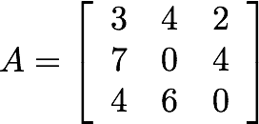
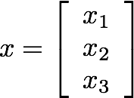
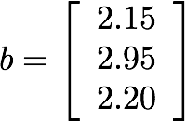
Simultaneous linear eqn
Collect the unknowns: cost of tangerine (x1), banana (x2), and peach (x3) into a vector x; collect coefficients of x into a matrix A; collect right hand side numbers into a vector b; this will result in an equation of the form…
3 | x1 | + | 4 | x2 | + | 2 | x3 | = | 2.15
7 | x1 | + | 0 | x2 | + | 4 | x3 | = | 2.95
4 | x1 | + | 6 | x2 | + | 0 | x3 | = | 2.20

Slide 29

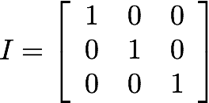

To find the unknowns, i.e., component in vector x, left multiply this equation by the inverse of matrix A
identity matrix
inverse of matrix A
Therefore, the unknowns are found by multiplying the inverse of matrix A (if it exists) by vector b
SOLUTION

Slide 30
In matlab
To solve Ax=b in MATLAB, you need to first check if the inverse of matrix A exists, and if it does, then compute the inverse of matrix A and multiply it by vector b, i.e., inv(A)*b
DETERMINANT
To check if the inverse of A exists, use MATLAB’s det command
INVERSE
To compute the inverse of matrix A, use MATLAB’s inv command
ALTERNATIVE METHOD
Since A is a matrix and b a vector, then you can use the left matrix divide operator (see Using MATLAB as a calculator) to solve Ax=b, i.e., A\b (note that you still need to check if the determinant of A exists)

Slide 31
Sample code
example
Let A=[3 4 2;7 0 4;4 6 0] and b=[2.15;2.95;2.20].
>> det(A) %returns 76, which means that it exists
>> x=inv(A)*b %returns x=[0.25;0.20;0.30]
Alternatively
>> x=A\b %returns x=[0.25;0.20;0.30]

Slide 32
Relational & Logical Operators
relational operators
Logical operators
operator | SYNTAX
Equal | ==
Not equal | ~=
Greater than | >
Less than | <
Greater or equal | >=
Less or equal | <=
operator | SYNTAX
And | & (element-wise) && (short-circuit)
Or | | (element-wise) || (short-circuit)
Not | ~
XOR | xor
All true | all
Any true | any
Note: Boolean values: 0 is false; nonzero is true
For a detailed list of operators see: help .

Slide 33
Conditional statements
if-Else
structure
If
Structure
if-Elseif-else
structure
if (condition)
command(s)
end
if (condition)
command(s)
else
command(s)
end
if (condition)
command(s)
elseif (condition)
command(s)
.
.
.
else
command(s)
end
Note: Conditional statement within the parentheses will evaluate to 0 (false) or 1 (true)
Source: MIT OpenCourseWare (http://ocw.mit.edu)

Slide 34
Conditional statements
Let a=14.2, b=12.3.
example 1 - if statement
if (a > b) %check if a is greater than b
c=‘a is greater than b’; %create new variable
end
example 2 - if-else statement
if (a > b) %check if a is greater than b
c=‘a is greater than b’; %create new variable
else %if a is not greater than b, then
c=‘a is less than b’; %create new variable
end
example 2 - if-elseif-else statement
if (a > b) %check if a is greater than b
c=‘a is greater than b’; %create new variable
elseif (a < b) %if a is not greater than b, then
c=‘a is less than b’; %create new variable
else
c=‘a and b are equal’; %create new variable
end

Slide 35
Try in class
Write a MATLAB code to assess whether Year entered by user is a Leap year or not.
Use input to solicit user input
Use if and if else to verify whether the year entered is leap year
Note:
Begin using a constant value (var year=1996;)
If your logic works, add prompt to enter variable value.

Slide 36
Try in class
Leap Year
If year is divisible by 4, proceed to step 2 or skip to step 5
If year is divisible by 100, proceed to step 3 or skip to step 4
If year is divisible by 400, proceed to step 4
Year is Leap Year (end)
Year is not Leap Year (end)

Slide 37
Loops: for
for-loops are used for a known number of iterations
loop variable
Defined as a vector, e.g., ii=1:10
Scalar within the command block
Does not have to have consecutive values (though, it’s usually cleaner if they’re consecutive)
for-loop
Structure
for (loop-variable)
command(s)
end
Source: MIT OpenCourseWare (http://ocw.mit.edu)

Slide 38
Loops: for
example
Let a=[1 2 3 4] and b=[5 6 7 8]. Swap values of a and b.
c=a; %make a copy of vector a
for ii=1:length(a) %need to loop 4 times
a(ii)=b(ii); %at each iteration, swap numbers
b(ii)=c(ii); %at each iteration, swap numbers
end

Slide 39
Loops: while
while-loop is like a more general for-loop; do not need to know number of iterations
The command block will execute while the conditional expression, i.e., (condition), is true
Beware of infinite loops!
while-loop
Structure
while (condition)
command(s)
end
Source: MIT OpenCourseWare (http://ocw.mit.edu)

Slide 40
Loops: while
example
Let a=[1 2 3 4] and b=[5 6 7 8]. Swap values of a and b.
c=a; %make a copy of vector a
ii=1; %define a variable to count
while(ii<=4) %need to continuously check a condition
a(ii)=b(ii); %at each iteration, swap numbers
b(ii)=c(ii); %at each iteration, swap numbers
ii=ii+1; %increment counter
end

Slide 41
Acknowledgment
Based on handouts and lectures by Dr. Arash Mehboobin

